Slide 1
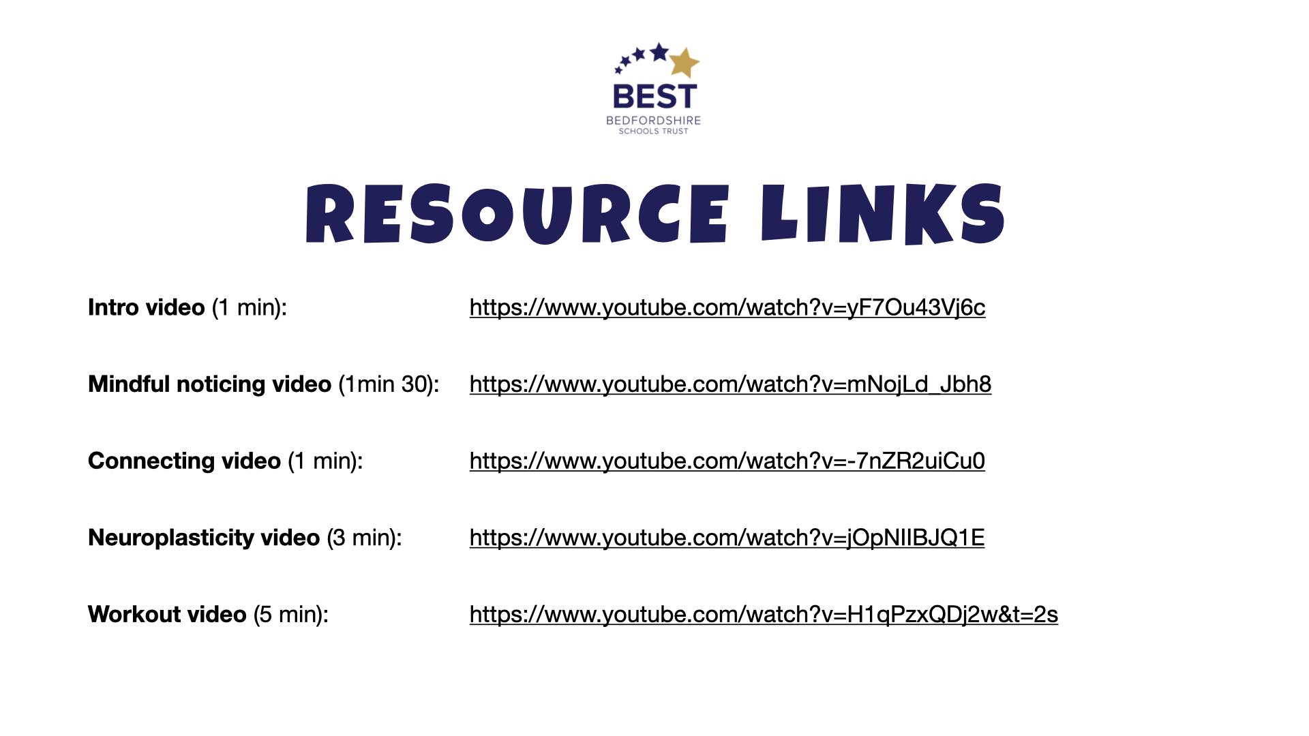
Secondary programme RESOURCE LINKS
Intro video (1 min): https://www.youtube.com/watch?v=yF7Ou43Vj6c
Mindful noticing video (1min 30): https://www.youtube.com/watch?v=mNojLd_Jbh8
Connecting video (1 min): https://www.youtube.com/watch?v=-7nZR2uiCu0
Neuroplasticity video (3 min): https://www.youtube.com/watch?v=jOpNIIBJQ1E
Workout video (5 min): https://www.youtube.com/watch?v=H1qPzxQDj2w&t=2s

Slide 2

Notes:
Intro video (1 min) : https://www.youtube.com/watch?v=yF7Ou43Vj6c

Slide 3

Notes:
Mindful noticing video (1 min 40 sec): https://www.youtube.com/watch?v=mNojLd_Jbh8

Slide 4

Notes:
Connecting video (1 min): https://www.youtube.com/watch?v=-7nZR2uiCu0

Slide 5
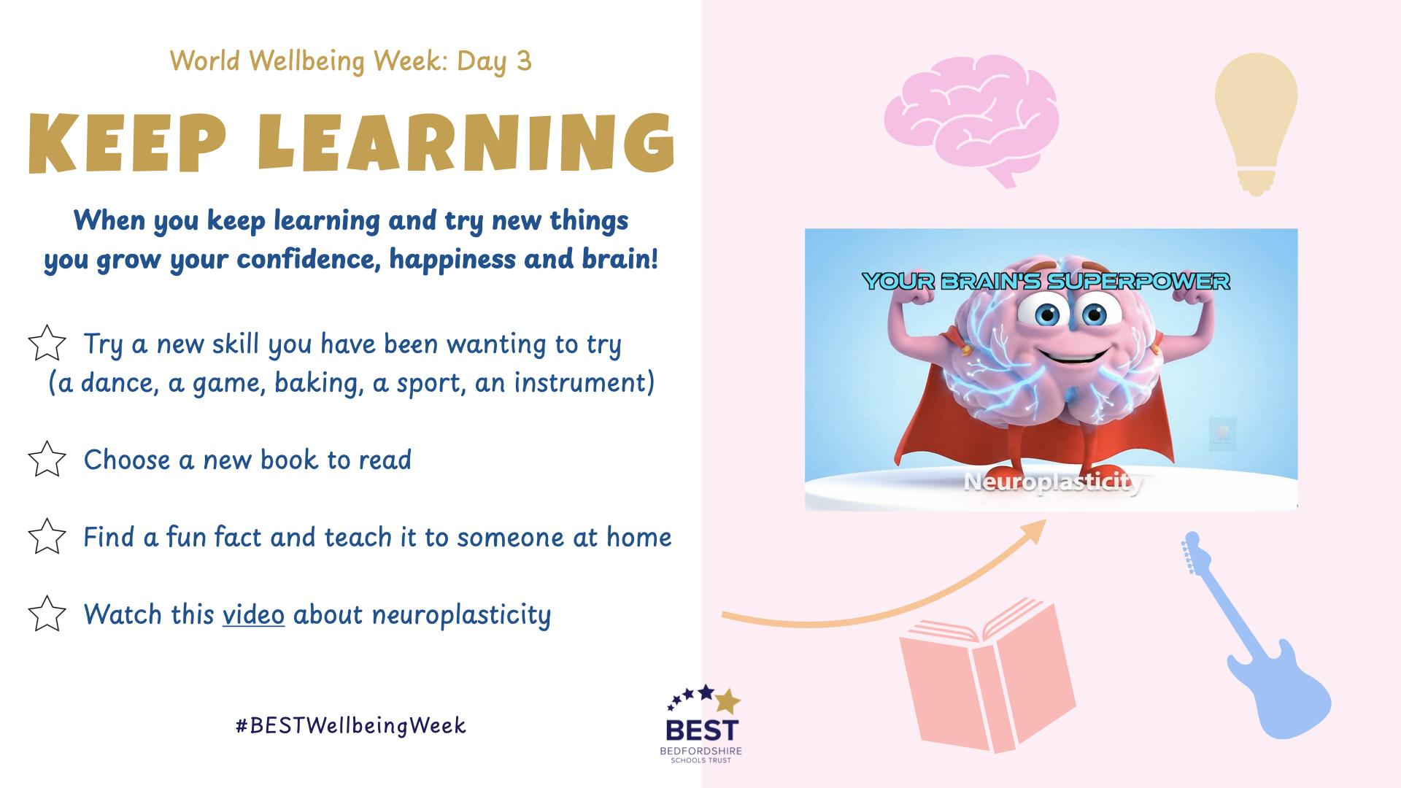
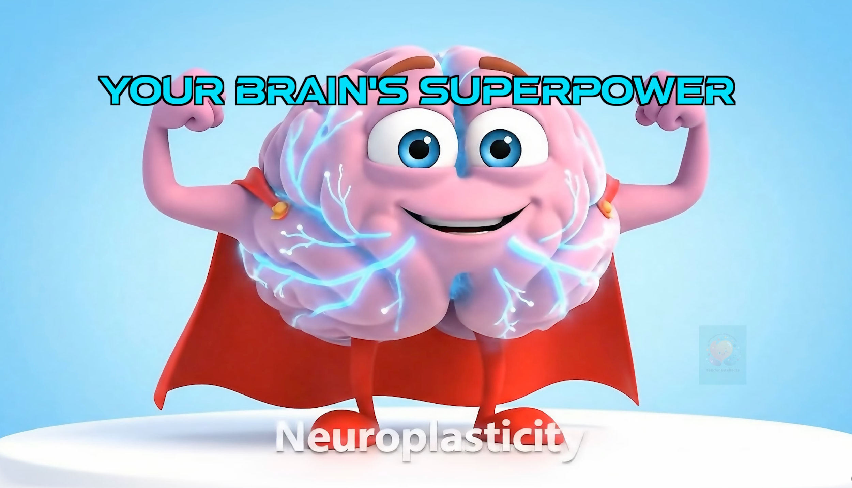
Notes:
Neuroplasticity video: https://www.youtube.com/watch?v=jOpNIIBJQ1E

Slide 6
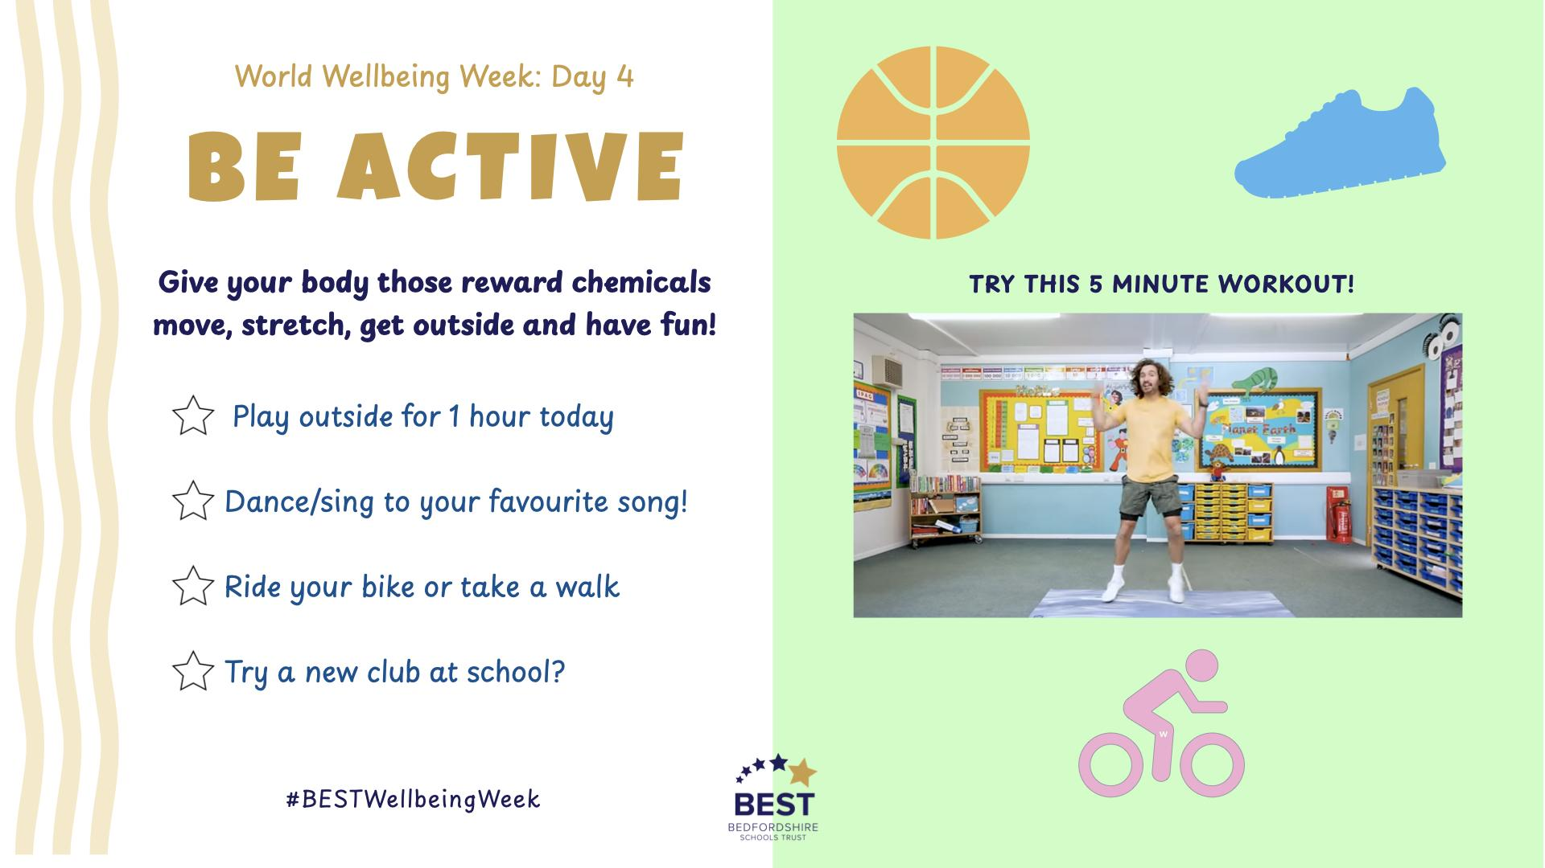
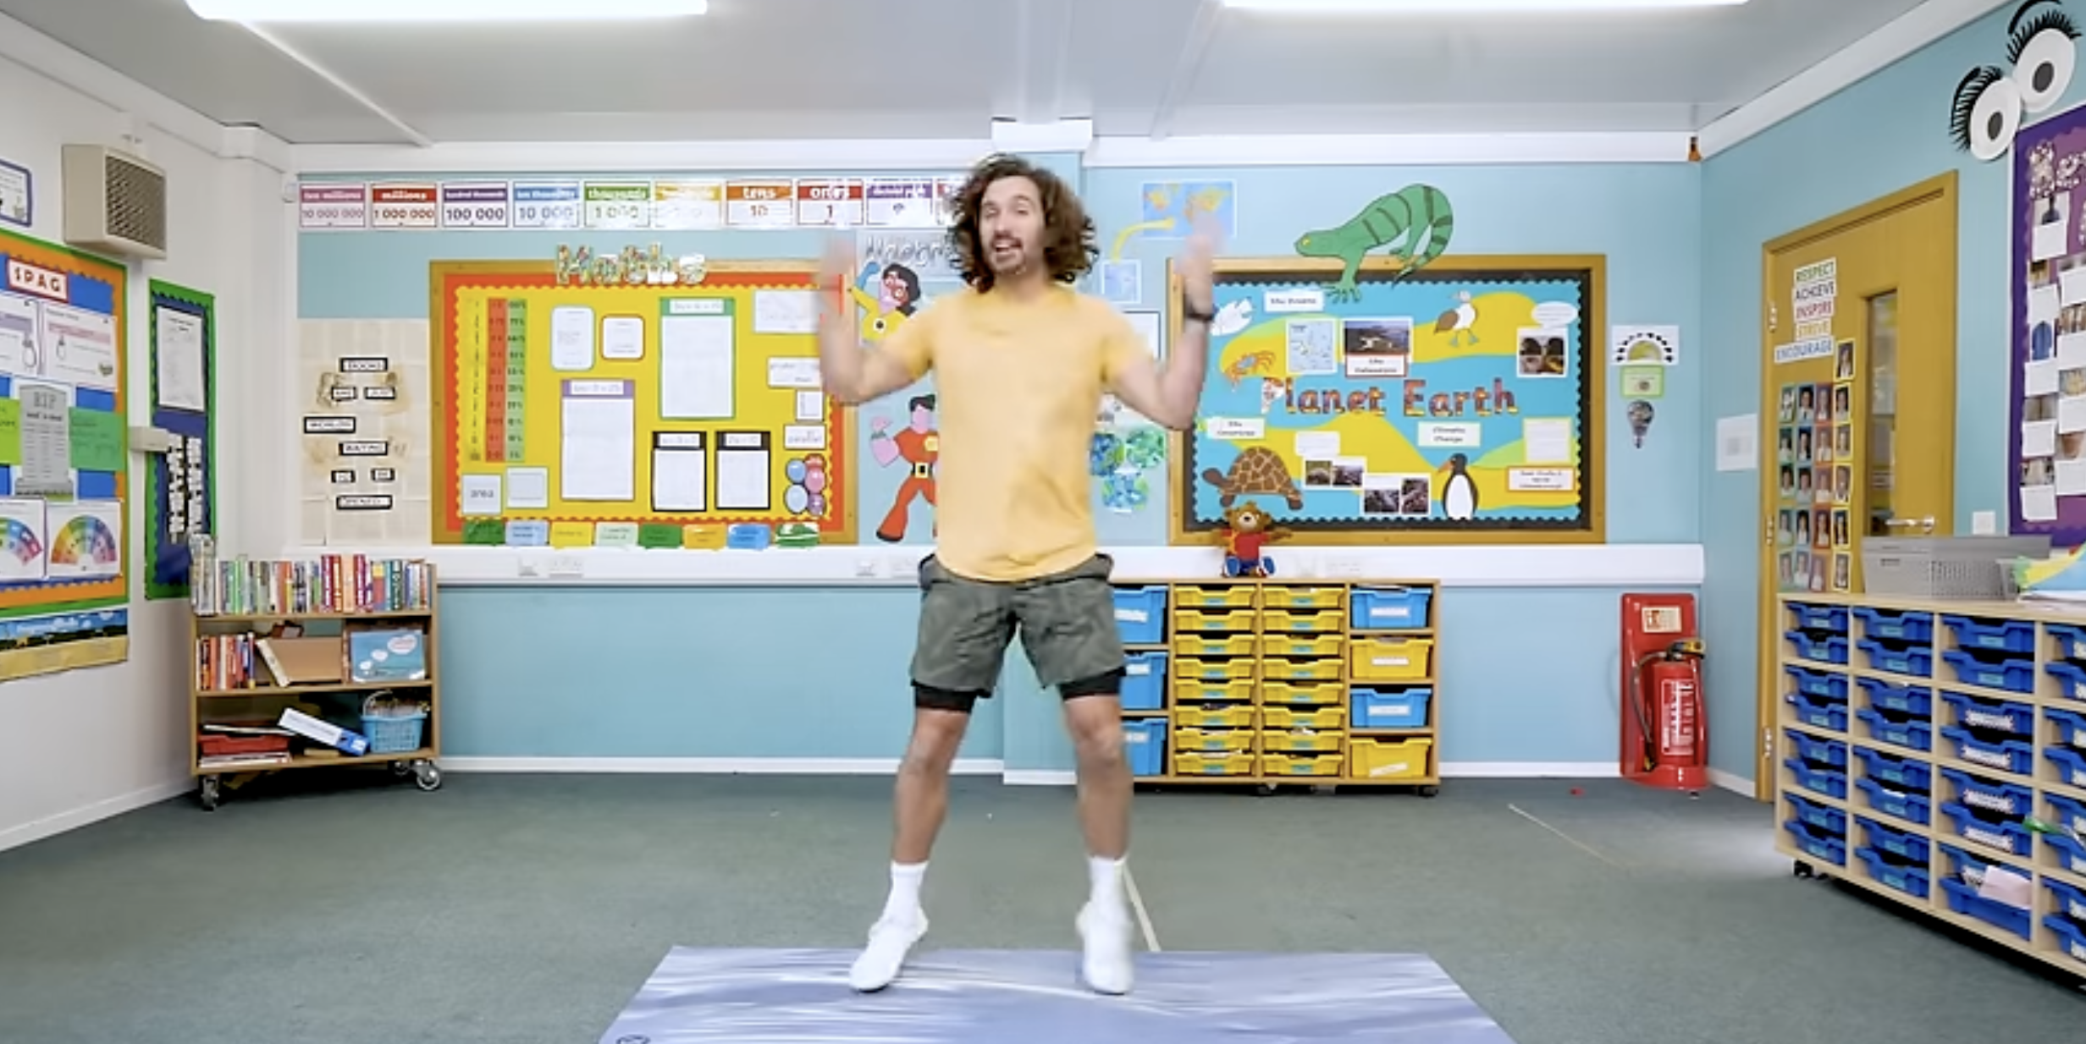
Notes:
Workout video (5 mins): https://www.youtube.com/watch?v=H1qPzxQDj2w&t=2s

Slide 7
